Slide 1
Chapter 2

Slide 2
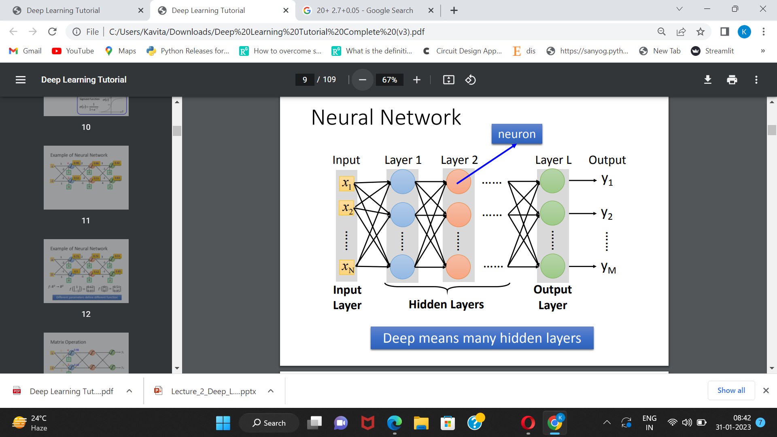

Slide 3
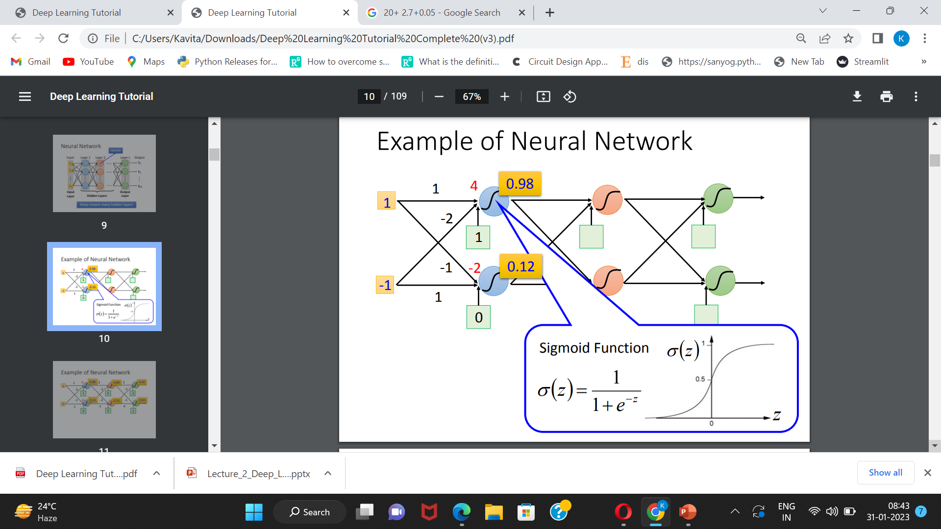

Slide 4
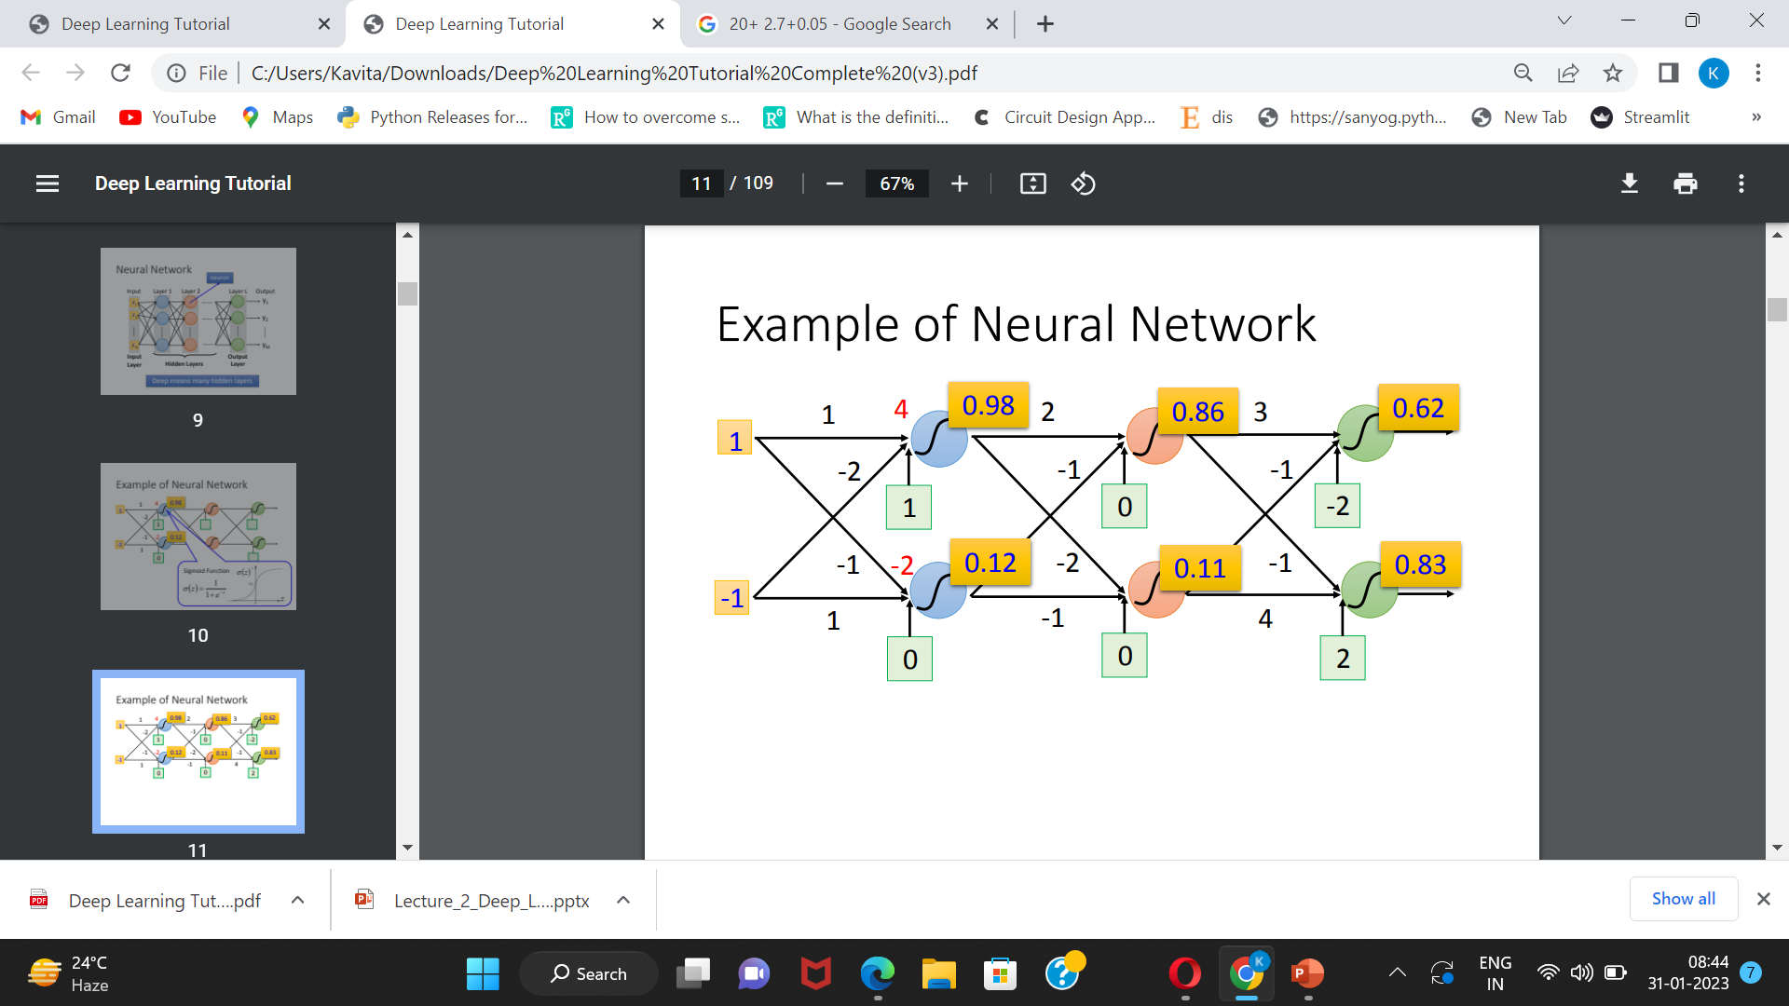

Slide 5
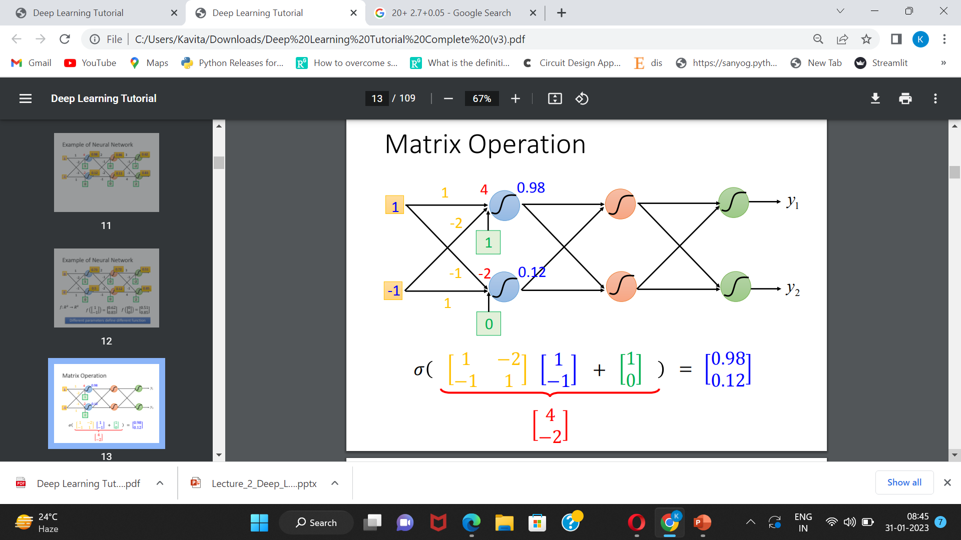

Slide 6
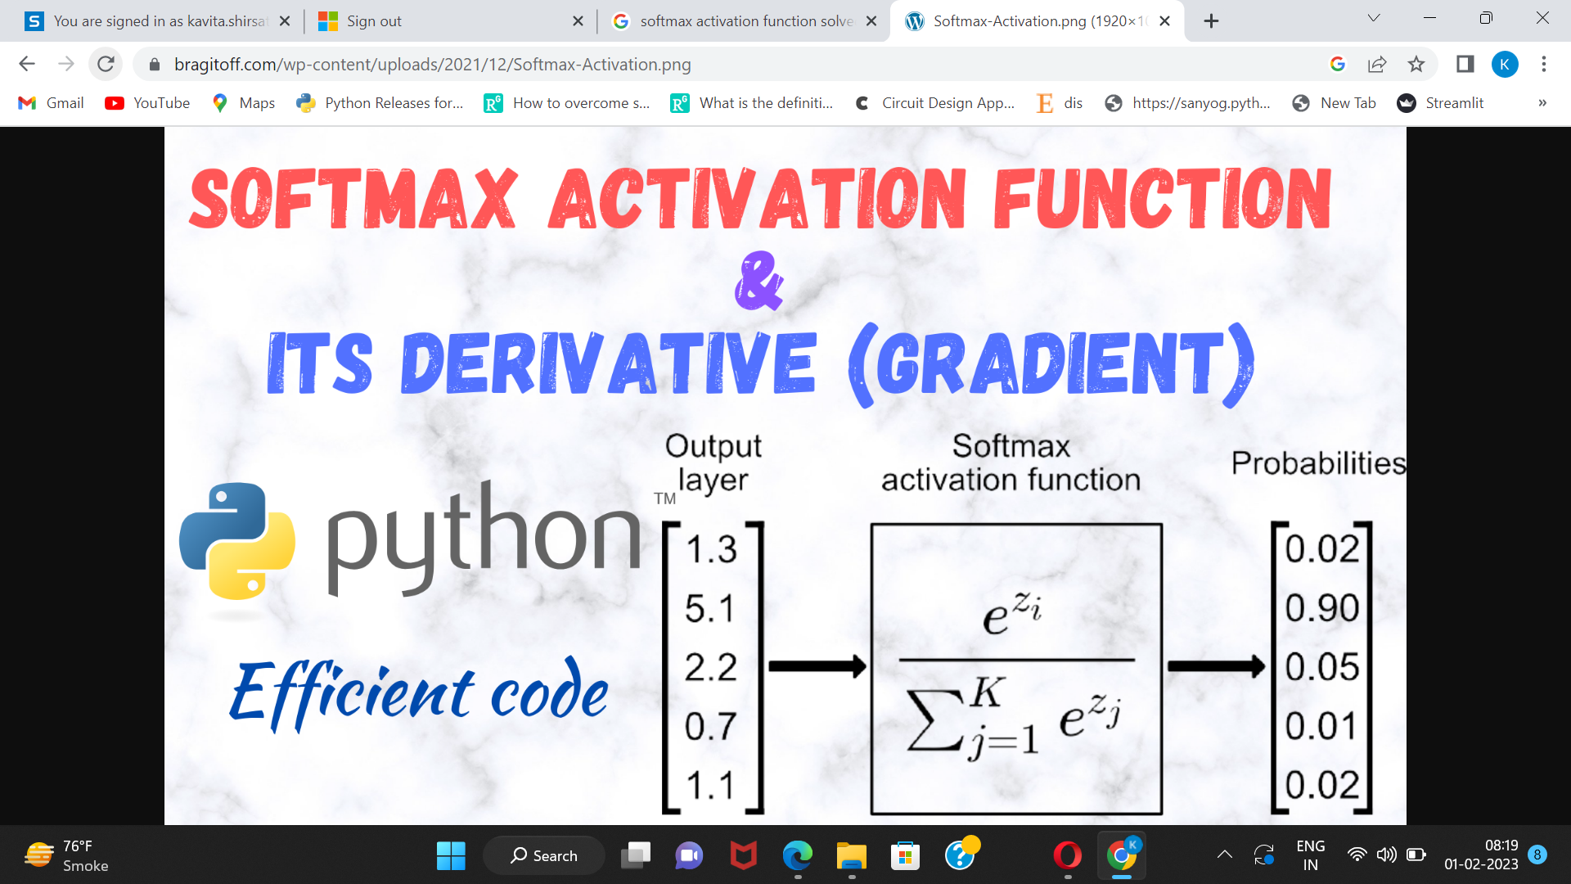

Slide 7
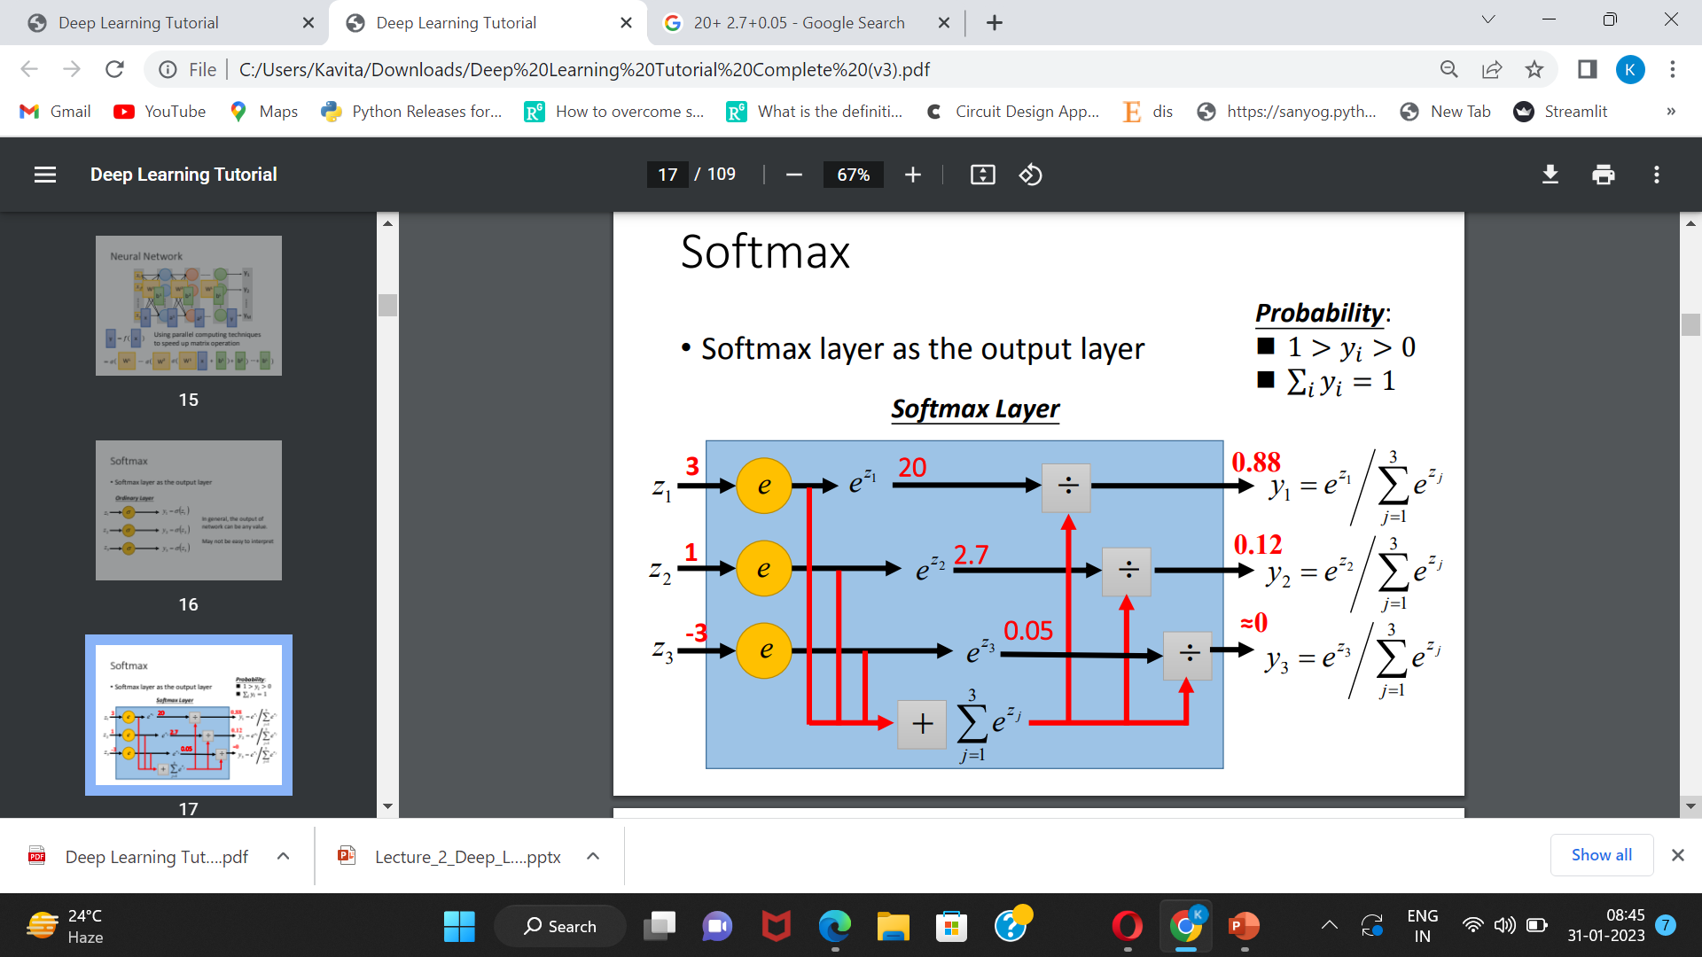

Slide 8
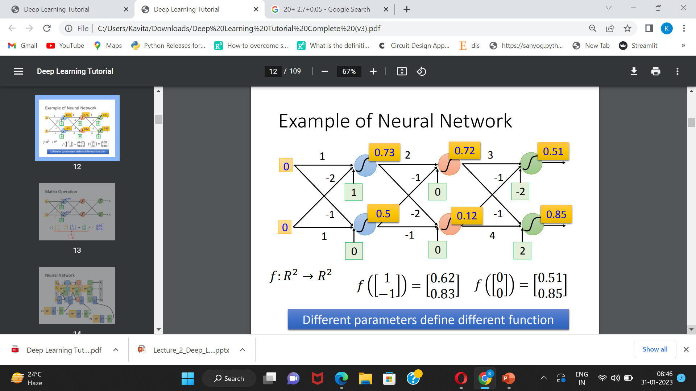

Slide 9
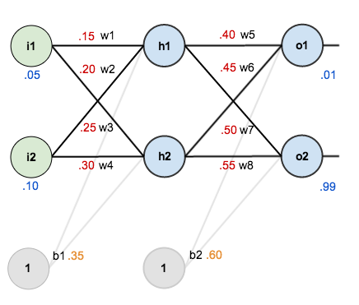
Backpropagation Example

Slide 10
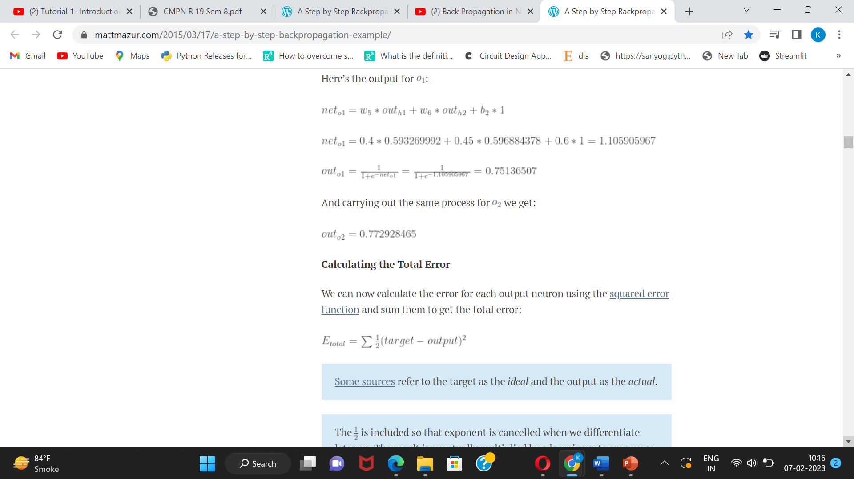
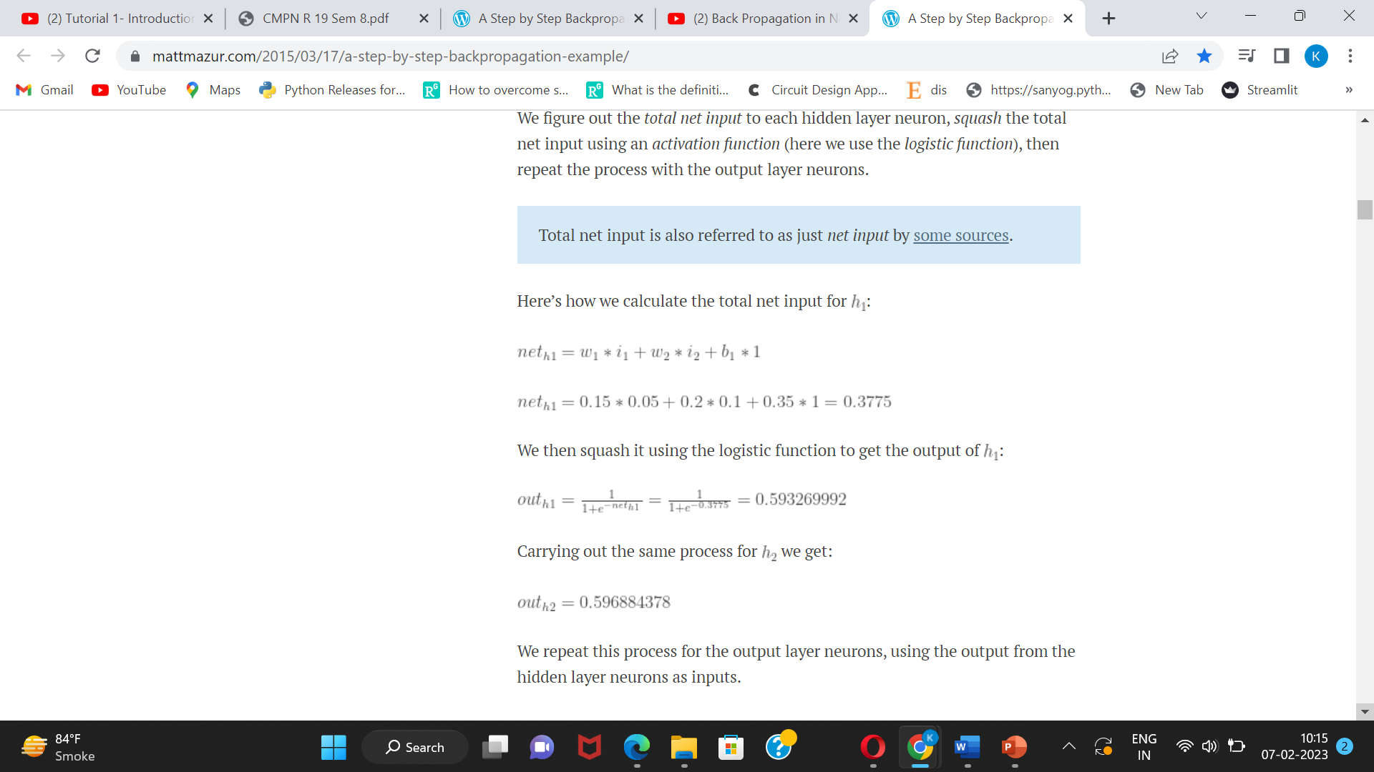
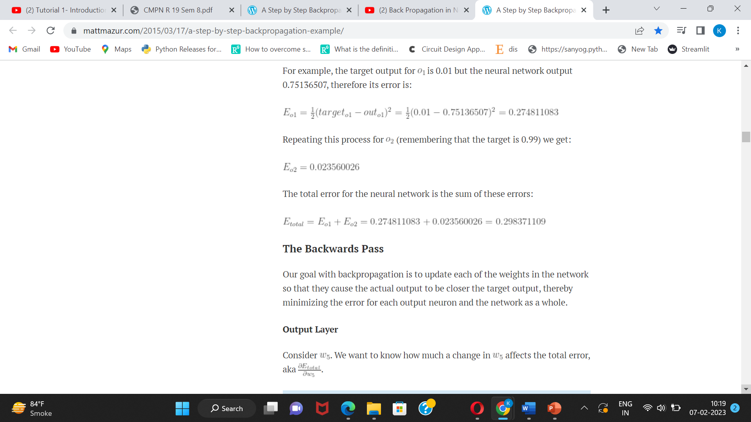
Backpropagation Example forward pass

Slide 11
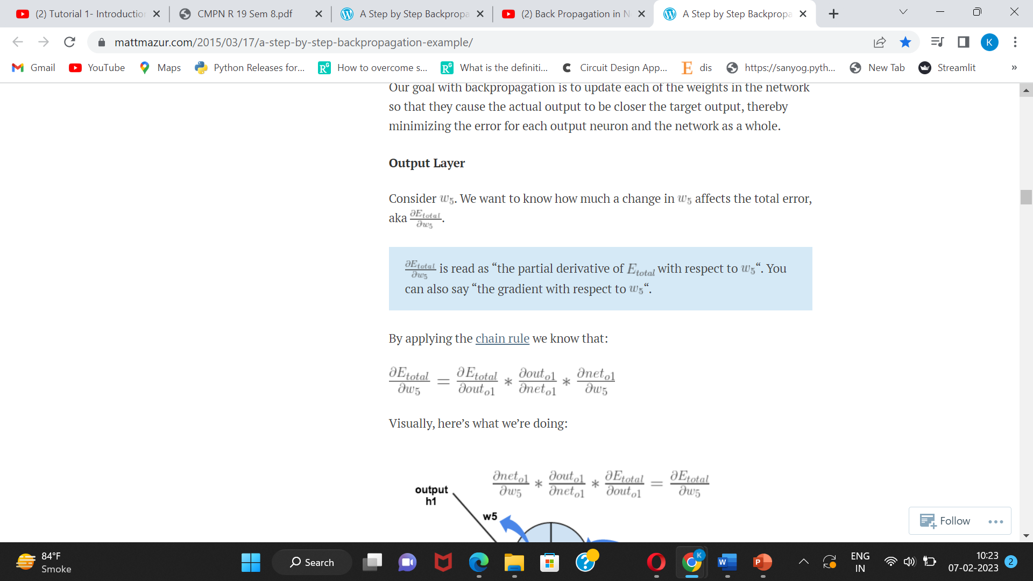
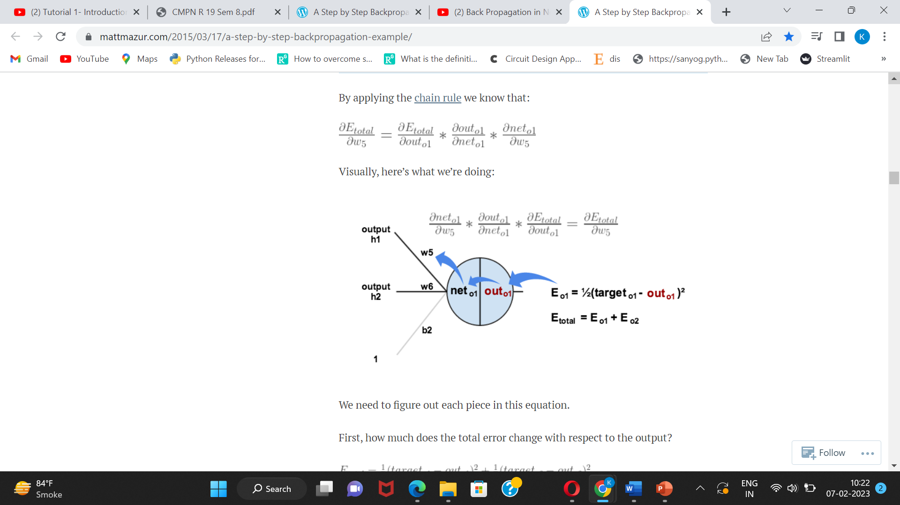
The Backwards Pass

Slide 12
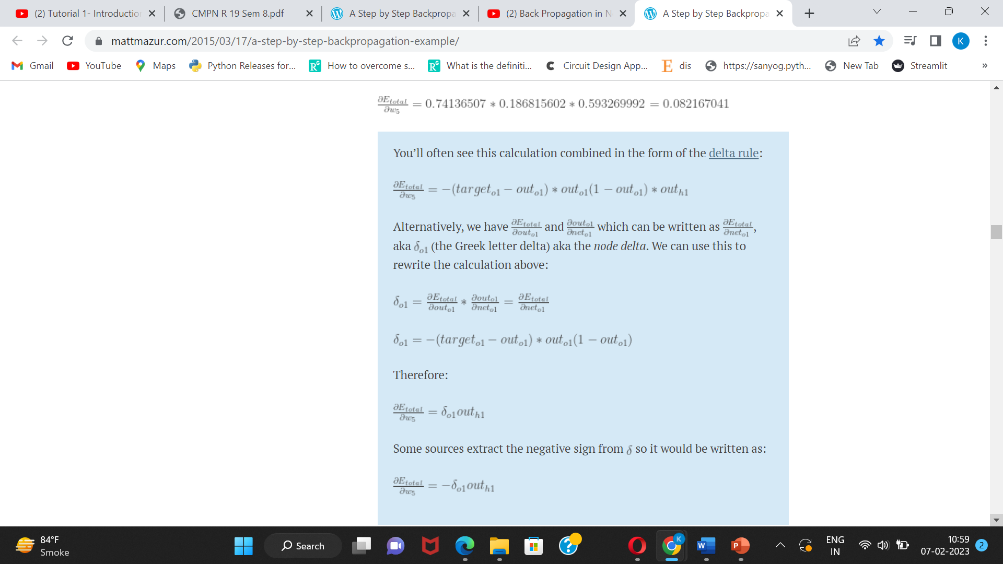
The Backwards Pass

Slide 13
The Backwards Pass
To decrease the error, we then subtract this value from the current weight (optionally multiplied by some learning rate, eta, which we’ll set to 0.5):
We can repeat this process to get the new weights , , and :

Slide 14
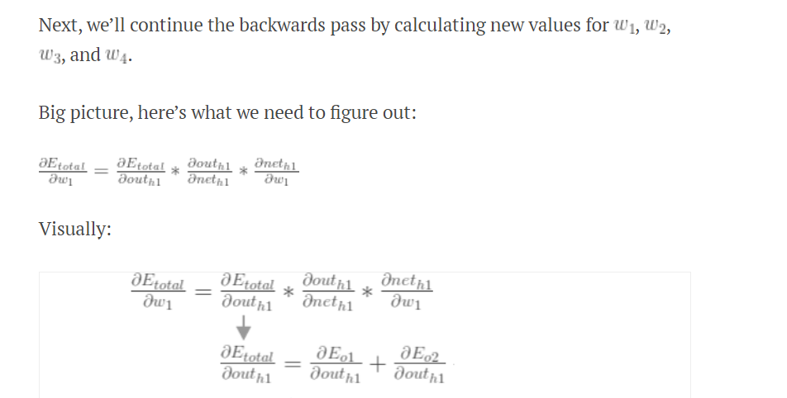
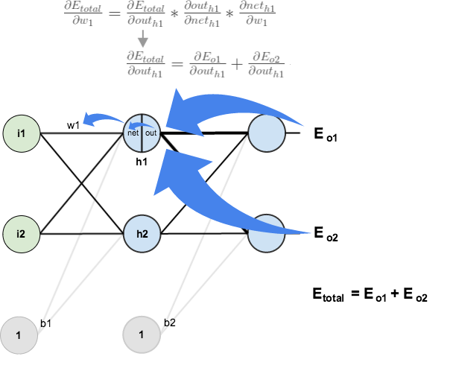
Hidden Layer

Slide 15
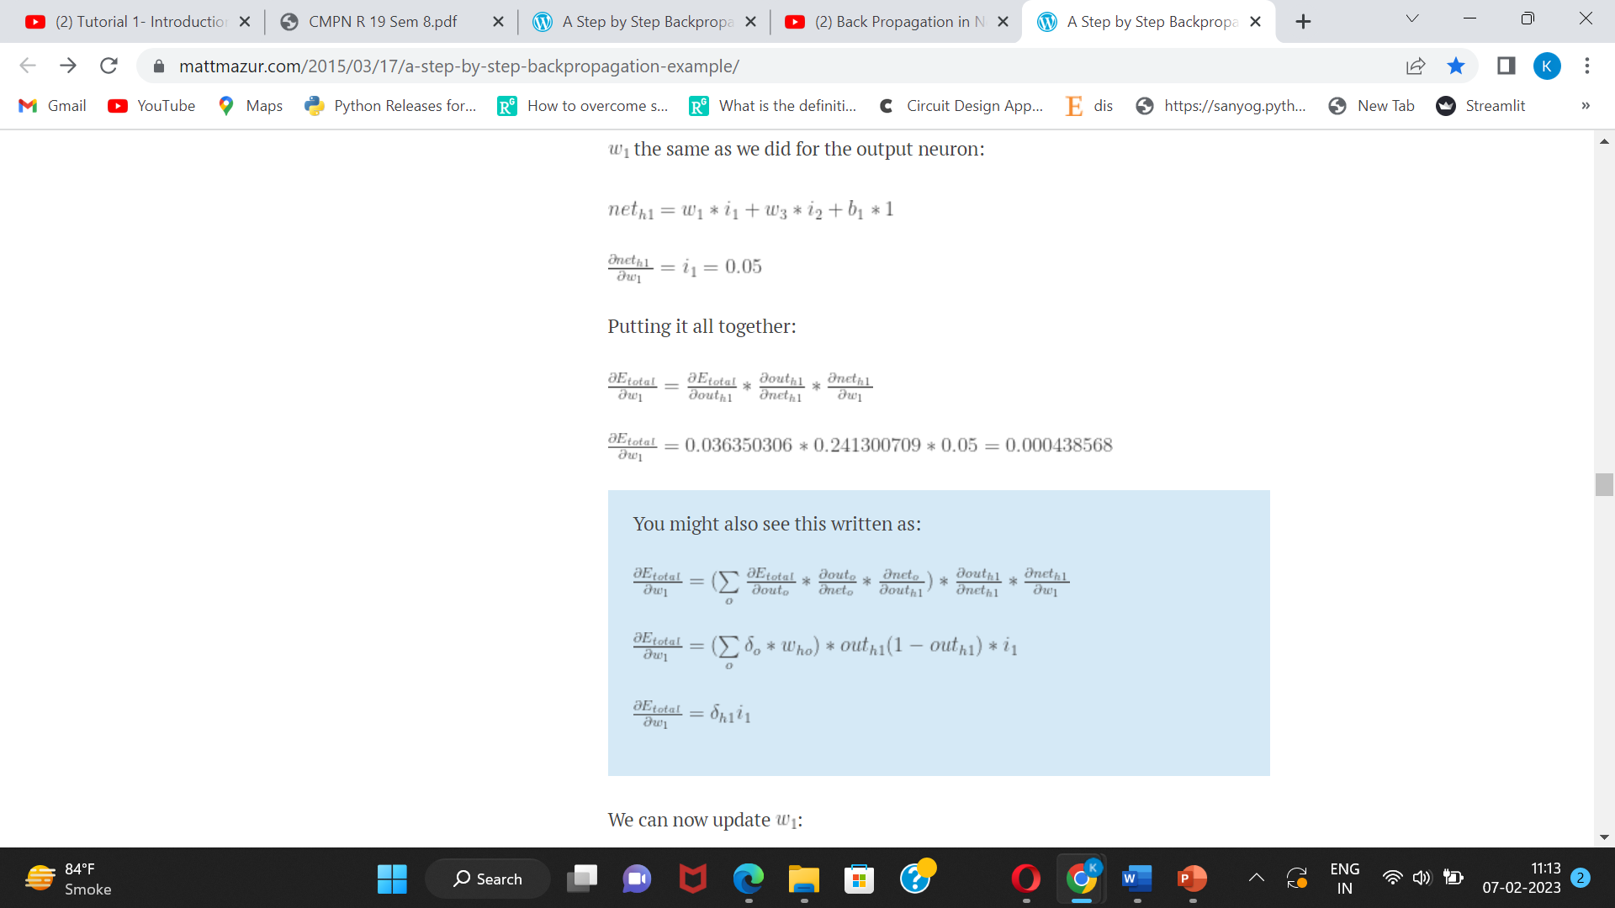
Hidden Layer
We can now update :

Slide 16
Hidden Layer
Repeating w2 w3 w4

